Slide 1

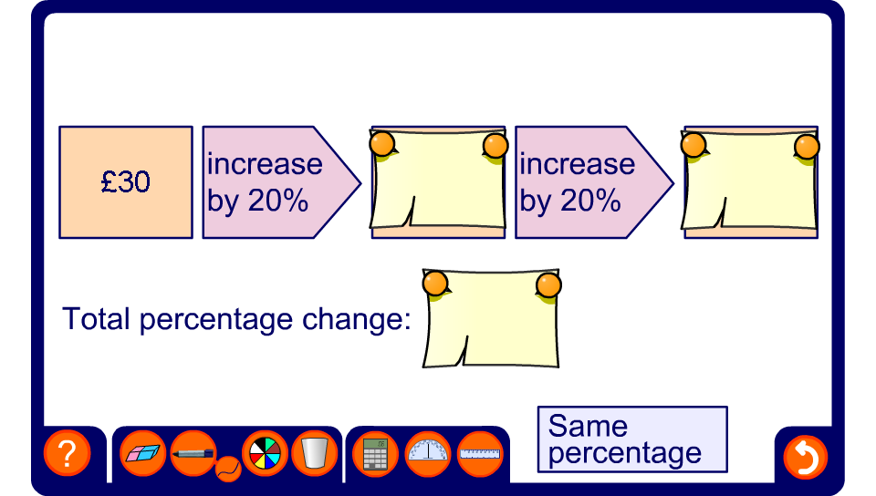


Compound percentages
Notes:
Use this slide to demonstrate the effect of following a percentage change with a second percentage change.
Ask pupils to predict whether the final amount is going to be greater than or less than the original amount.
Discuss methods to find the result of multiple percentage changes.

